Slide 1
Customer Retention
E-Commerce company

Slide 2
Data Description
Customer satisfaction has emerged as one of the most important factors that guarantee the success of online store; it has been posited as a key stimulant of purchase, repurchase intentions and customer loyalty.
A comprehensive review of the literature, theories and models have been carried out to propose the models for customer activation and customer retention.
Five major factors that contributed to the success of an e-commerce store have been identified as: service quality, system quality, information quality, trust and net benefit. The research furthermore investigated the factors that influence the online customers repeat purchase intention.
The combination of both utilitarian value and hedonistic values are needed to affect the repeat purchase intention (loyalty) positively. The data is collected from the Indian online shoppers. Results indicate the e-retail success factors, which are very much critical for customer satisfaction.

Slide 3
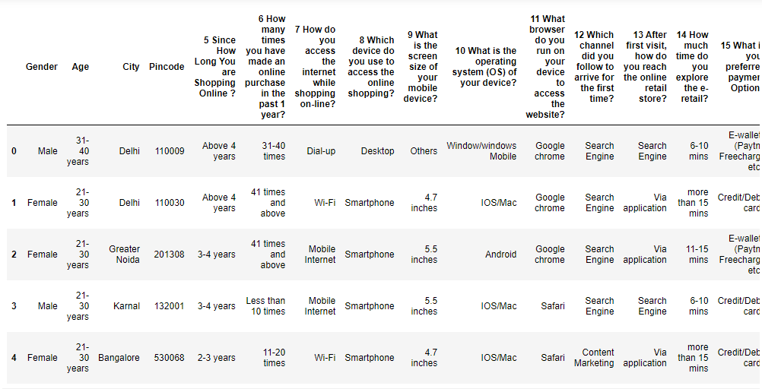
Data STRUCTURE

Slide 4
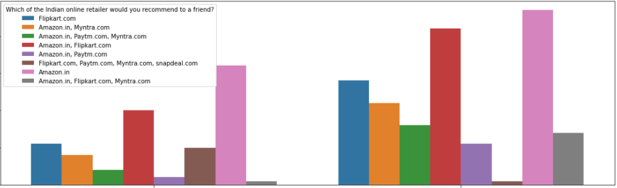
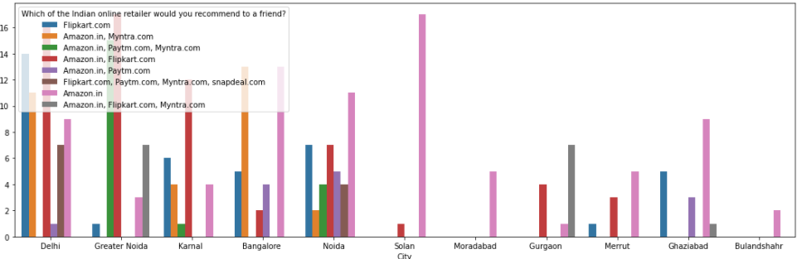
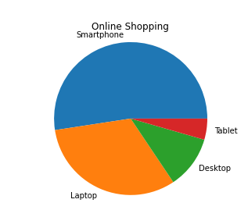
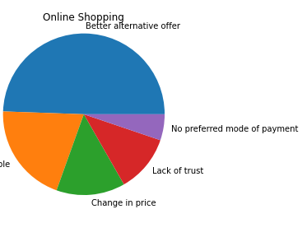
DATA VISUALIZATION

Slide 5
conclusion
In the dataset - We have a 2 set like general survey and custom survey. Based on the analysis in the dataset I have come for the conclusion and listed below. ALso, I have consider this as sample data because this data survey contain specific north zone of india.
These are the observation from my end:
1) Survey taken from the 11 cities in India for 5 e-commerce company. 2) Female customers are occupied 2/3 of survey and playing a major role in the Market. 3) Young peoples are mostly using the e commerce in the age of between 25 to 45. 4) E-commerce need a more trust in the people mindset, So that is important but Flipkart had a lack of trust. 5) E-Commerce accessabilty is more important. Amazon and Mytra have a more accessiblity in all site like Ios. 6) Product availability with full description and easy payment option which have more details.
Based on the comparison in the data. Most of the person will refer to the friend which is Amazon. Here, Amazon alone have 35% market occupency and have 25% along with other E-commerce company. Second position is flipkart have 30% share.
Major Reason behind for Amazon first position which is listed below:
Easy Navigation
Multiple offer with product
Multiple payment option
Easy accessablity.
Customer Trust
Product Quality
Discount on product

